Slide 1
Deep Neural Networks for Policy Representation in Continuous Action domains
Sanjay Thakur (260722338)
Sumana Basu (260727568)

Slide 2
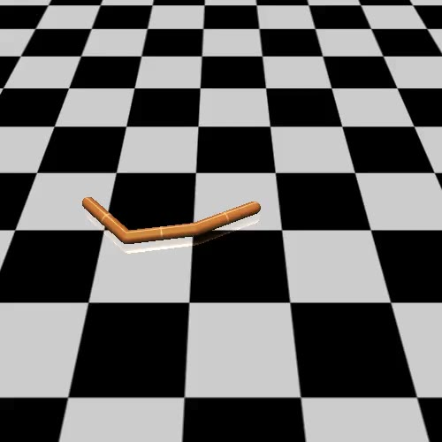
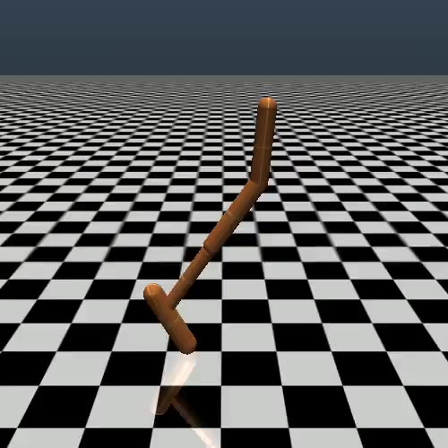
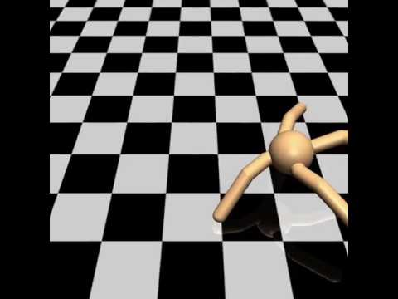
Environments: (MuJOCO’s locomotion tasks):
Swimmer
Hopper
Ant
Why are these tasks(locomotion) challenging:
Both observation space and action space is continuous, and hence discretization is not useful.
All spaces have high degrees of freedom.
There exists a local-minima where it can decide either not to move forward at all, or fall over slowly.

Slide 3
Implementation
Algorithm used: REINFORCE with baseline
Neural Network Architecture for both Actor and Critic
Input – Observation from the environment
Output – Magnitude of the action to be taken in each dimension

Slide 4
Neural Network Implementation: Used Tensorflow
Neural Network Architecture for both Actor and Critic
Input Layer (Degrees of freedom in the observation space)
Hidden layer 1 (100 nodes)
Hidden layer 2 (50 nodes)
Hidden layer 3 (25 nodes)
Final layer (Degrees of freedom in the action space)
Activation : ReLU

Slide 5
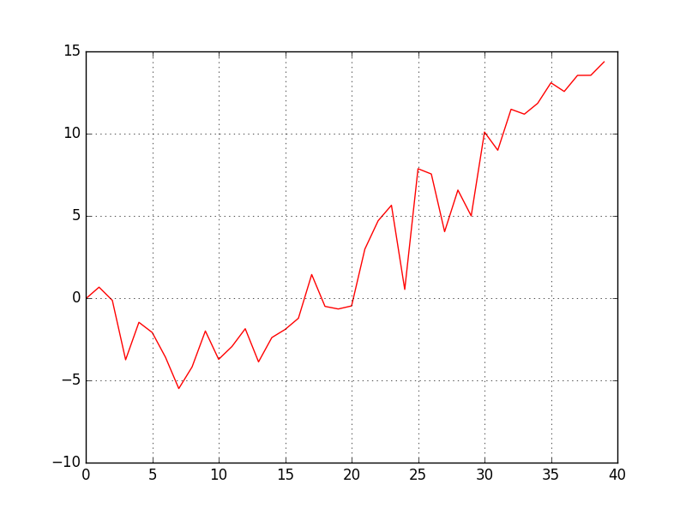
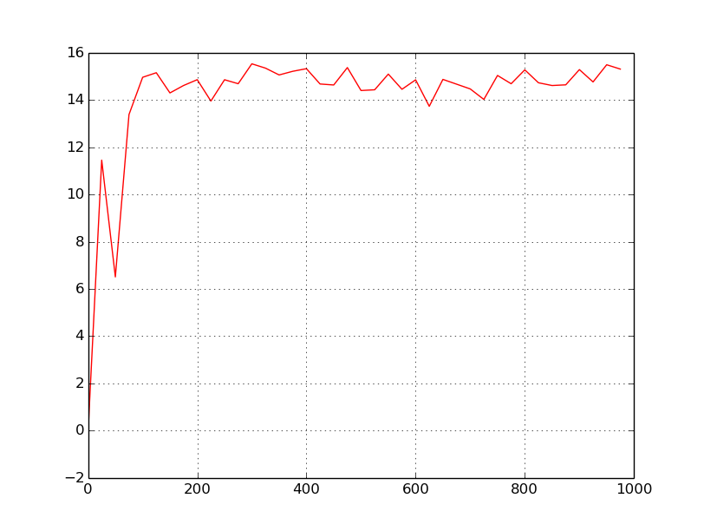
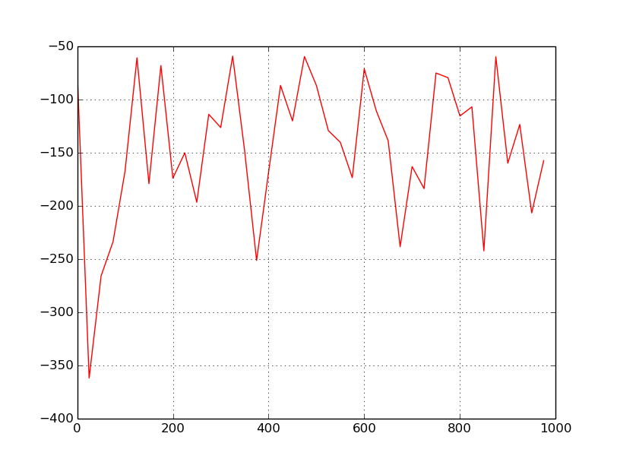
Results
Rewards over episodes
REINFORCE on swimmer
REINFORCE on hopper
REINFORCE on Ant

Slide 6
Relevance
Using Deep Learning for feature mapping frees us from environment specific feature engineering
Most real world tasks are of high degrees of freedom
Policy gradient techniques are better than Q-learning algorithms due to end to end structure

Slide 7
Scope for improvement:
Could use some smarter strategy that would mix exploration to policy improvements intrinsically.
Try using some non-gradient methods

